Slide 1
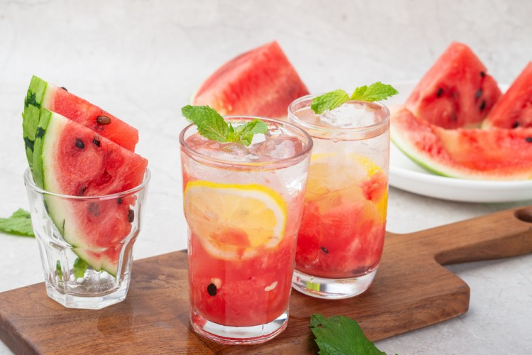
Enough for 1 people
The cooking time is 10 minutes
Mohito Al-Bateekht
ingredients
- Watermelon: cubes (no seed)
- mint paper: paper (fresh)
- lemon: cubes (peel)
- Soft mineral water, as needed
- Watermelon: slices (for decorative)
- Snow: as desired
preparation method
In the cup we put lemon, watermelon, mint.
Components are pressed with a spoon.
You add soda, ice.
He's decorated with watermelon chips and served ice cream.

Slide 2
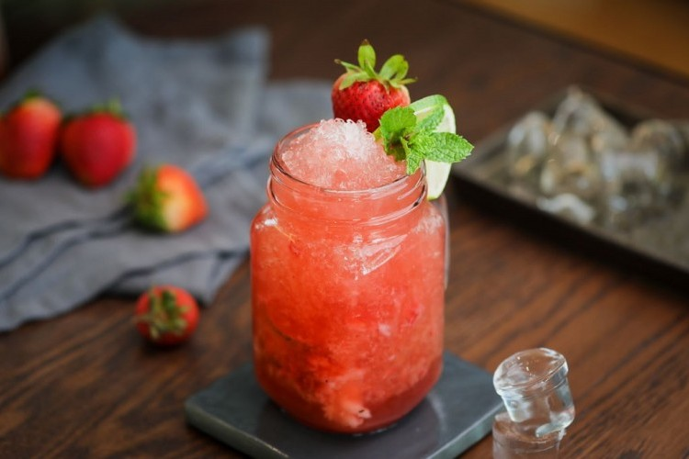
Enough for 1 people
The cooking time is 10 minutes
Muhito Tutu
ingredients
- Berries: 150 grams (problem)
- Lemon juice: 50 m
- Gas mineral water: 150 mL
- lemon: 3 slices
- mint paper: 3 g
- Ice: cut
- strawberries: as desired (for decoration)
- berries: as desired (for decoration)
preparation method
In the presentation cup, we put the mutant raspberry, and we tuck it in with the lemon slices
green mint then add lemon juice and ice.
We're adding up the invasive water.
Serving and decorating with slices of lemon, strawberries and wild berries.

Slide 3

Enough for 1 people
The cooking time is 10 minutes
Mohito
ingredients
- mint paper: 15 sheets
- Brown sugar: small spoon
- lemon juice: 1/2 cup
- Snow: as desired (furnished)
- Soft drinks: three-fourths of the cup (August ships)
- lemon: as desired (sliced)
preparation method
Harris in a small mint pot with brown sugar and lemon juice until the mint smells.
Place the mixture in a cup and add ice on top and some lemon slices.
Pour the ships up and feet the juice directly onto your whistle.

